Slide 1
D carb 4
Energy Projects
Soil Carbon sequestration for energy projects.

Slide 2
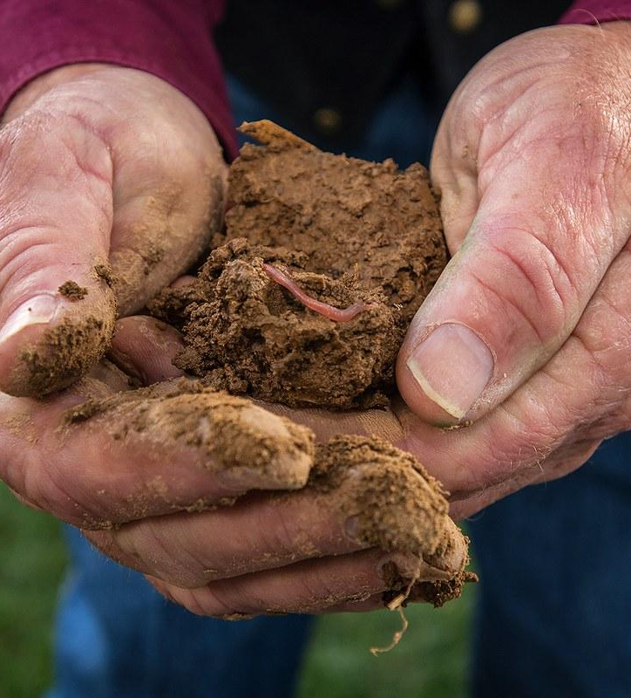
Soil Carbon Capture
The United Nations estimates by 2030, global soil carbon sequestration can potentially mitigate around five gigatonnes of carbon per year.
Soil is the skin of our planet. This thin layer of living material holds roots, water and nutrients, as well as a myriad of organisms and organic matter. To truly see the biodiversity it holds, one must look down; below the surface of the soil.

Slide 3
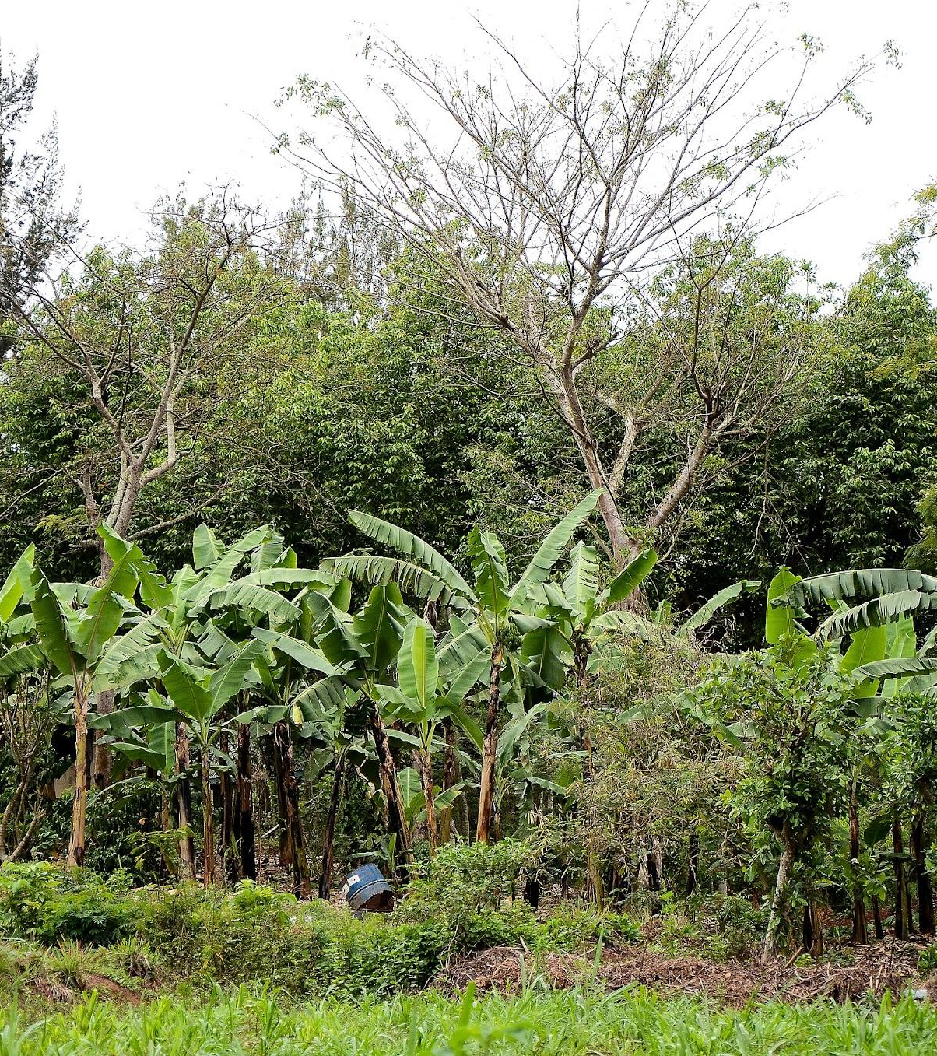
The soil can sequester carbon, improve biodiversity, recharge aquifers, boost rural economies, and most importantly for the future of humanity, stabilize the climate.
Restoring soil through regenerative agriculture, including organic no-till cropping, holistic planned grazing, and agroforestry, can provide food, water, and climate security for present and future generations.

Slide 4
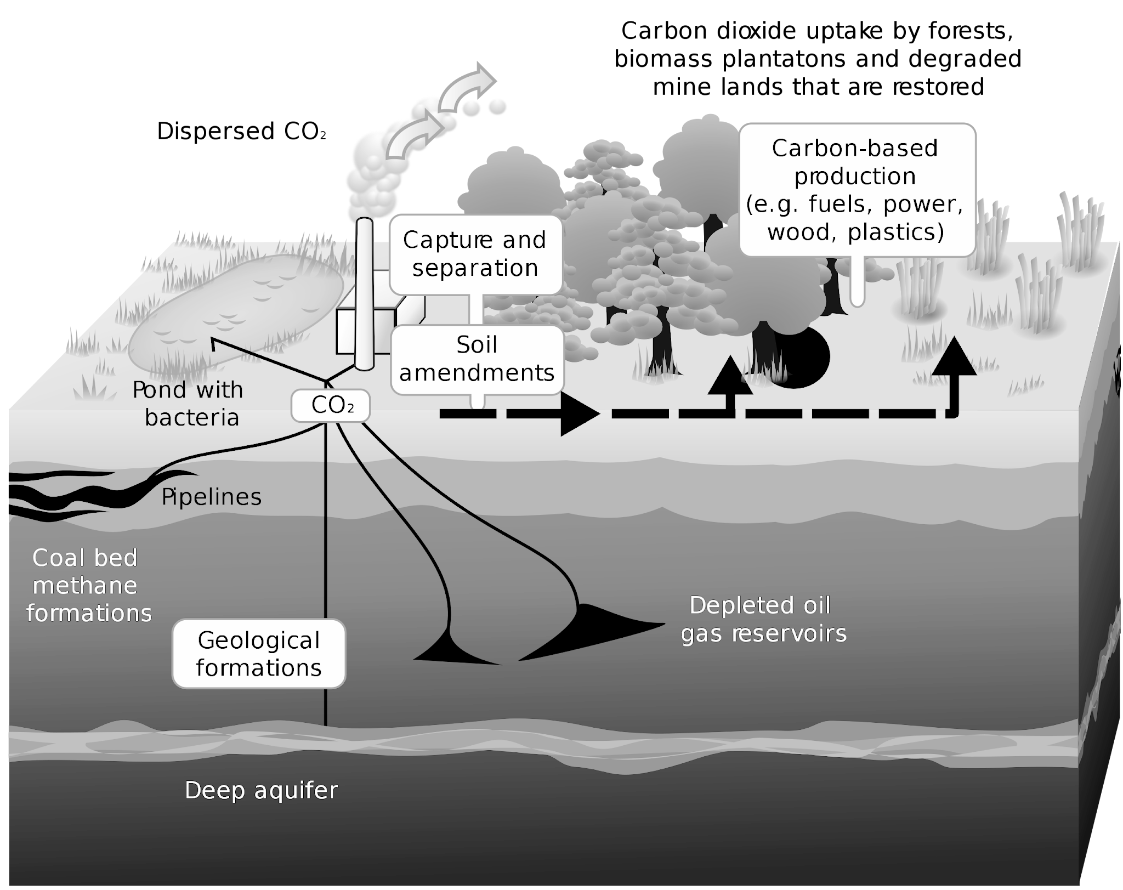
What is Soil Organic Carbon Sequestration
Soil Carbon Sequestration is the process of transferring CO2 from the atmosphere into the soil in the form of organic carbon.
This process begins with photosynthesis, where plants convert atmospheric carbon dioxide into organic compounds.
These compounds are then incorporated into the soil through plant residues and root exudates.

Slide 5
Our vision
This presentation outlines an approach to enhancing soil health and maximizing carbon sequestration through regeneration practices to potentially be implemented in potential Renewable Energy projects, through the regenerative agroforestry.

Slide 6
Understanding soil dynamics
Observation Phase Checking current situation of the soil, identifying local species, orography, etc.
Analysis Phase Environmental impact analysis.
Implementation
Introduction of regenerative species, check microbiota and biochar.

Slide 7
Observation Phase:
Analyze Existing Vegetation: Identify plant species present in the soil.
Consider Environmental Factors: Assess orographic features and environmental conditions.
Evaluate Pruning Susceptibility: Determine if plant species are amenable to pruning techniques.

Slide 8
Analysis Phase:
Vegetation Assessment: Understand the role of identified plants in soil regeneration.
Environmental Impact Analysis: Assess how orography and environmental factors influence soil health.
Pruning Potential: Determine the feasibility and impact of pruning on soil carbon capture.

Slide 9
Evaluation and Action Plan
Soil Analysis: Conduct thorough soil tests to measure organic matter levels and understand soil chemistry.
Carbon Density Assessment: Perform soil ignition tests to determine carbon density, crucial for setting a baseline for carbon capture goals.

Slide 10
Implementation
Species introduction
Biochar application Environmental impact analysis.
Microbiota enhancement
Using methods like JADAM to enhance microbiota.
High microbiota soil planting

Slide 11
Implementation
Regenerative Species Introduction: Introduce plant species known for their regenerative effects on soil health.
Biochar Application: Utilize biochar to improve soil structure, enhance nutrient availability, and increase carbon sequestration.
Microbiota Enhancement: Accelerate the introduction of beneficial microorganisms using methods like JADAM, enriching soil life and health.
High Microbiota Soil Planting: Select and plant species in soil enriched with high levels of microbiota, fostering a self-sustaining ecosystem.

Slide 12
Implementing soil carbon capture in renewable energy projects

Slide 13
Mixing SCS with renewable projects
Solar Energy Projects
Wind energy Projects
BESS Projects

Slide 14
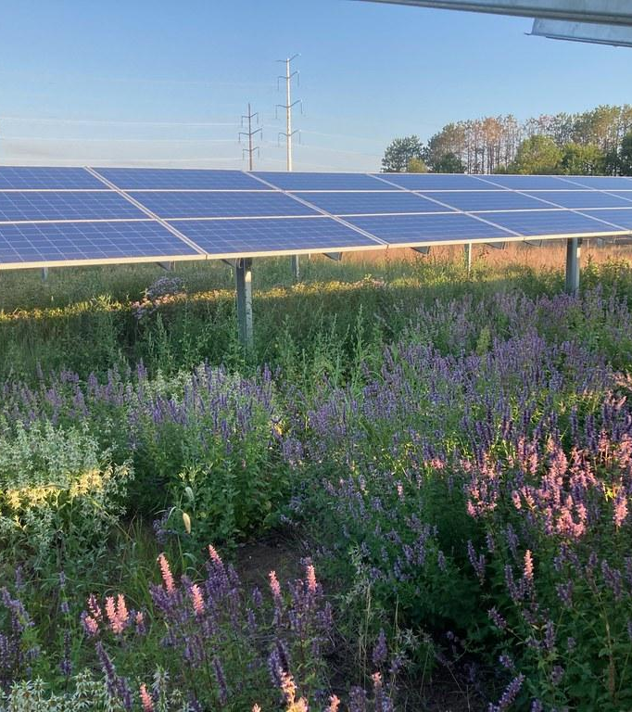
Solar energy Projects
In agreement with land owner, can be set as farming project to cultivate shadowlike species, like carrot, blueberry or coffee, or agroforestry.

Slide 15
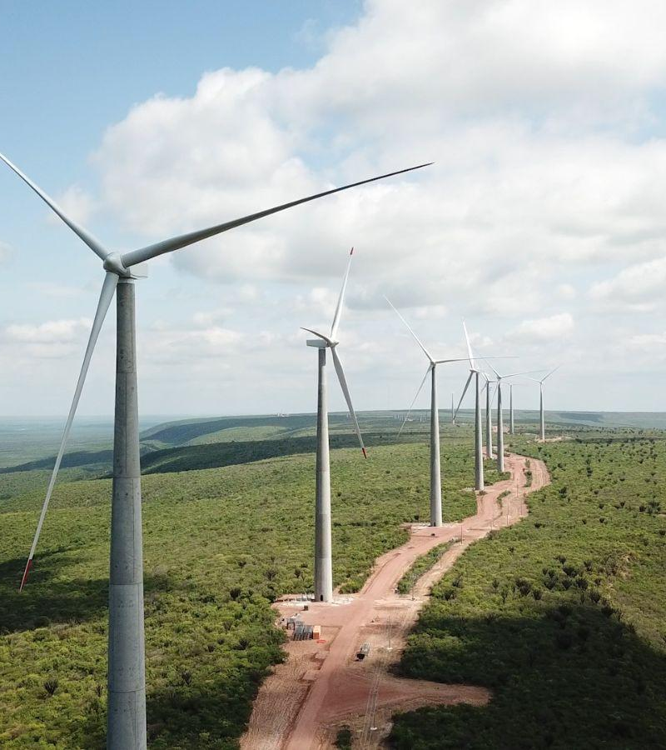
Wind energy projects
Can use agroforestry or farming as well, and is a good place to interact with local ranchers to use flock of sheeps as pruning tools.

Slide 16
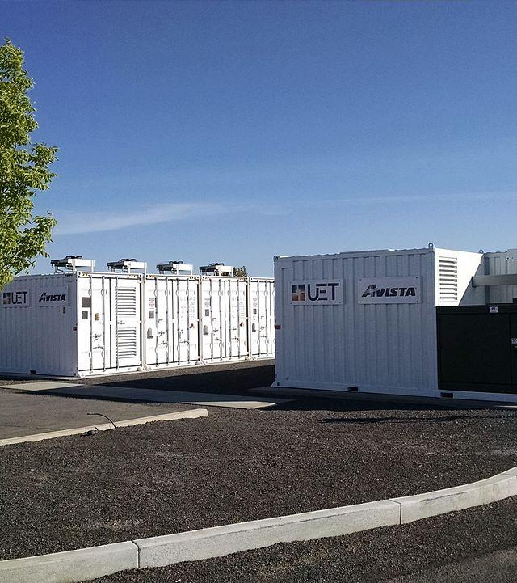
BESS Projects
In the same way than previous projects.

Slide 17
D carb 4
Energy Projects

